Slide 1


Slide 2
HELLO
WORLD!
Index
01. Introduction
02. Game Concept
03. Game Demonstration
04. Q&A

Slide 3


INTRODUCTION
Quality
Welldone
Energentic
Royal
Team
Yeah

Slide 4
INTRODUCTION
TEAM MEMBER
PRODUCT MANAGER
WONJU_CHO
| TECHNICAL MANAGER
MINKI_CHO
| DESIGNER
GUYOUN_PARK
| PRODUCER
UIJIN_LEE

Slide 5
INTRODUCTION
BOXES
+
ESCAPE
BOX ES CAPE

Slide 6

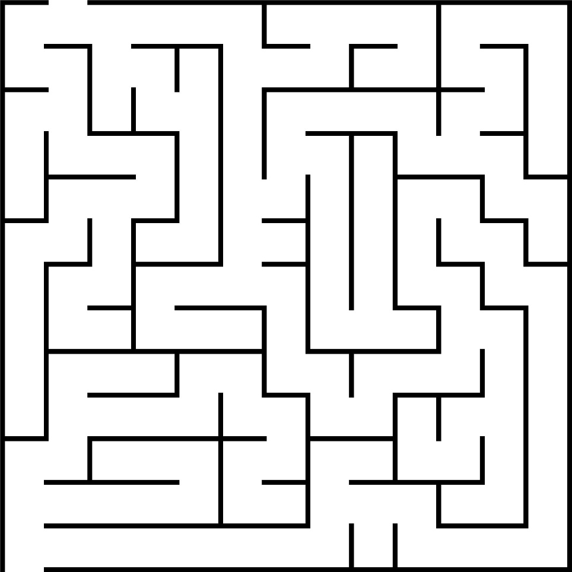
GAME CONCEPT
+

Slide 7
Q&A
Q&A

Slide 8
End
Thank You!

